Slide 1
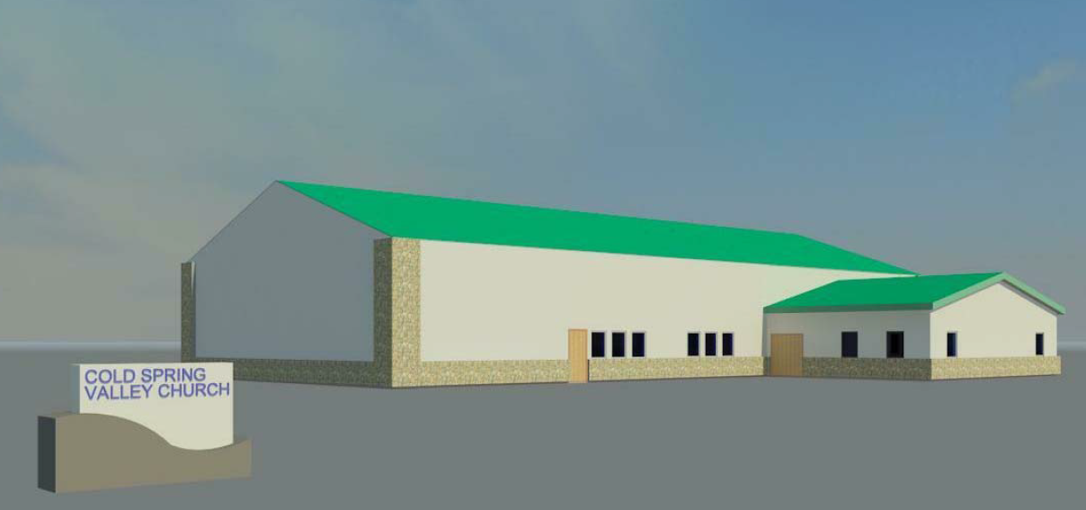
WADMIN18-0003 Cold Springs Valley Church
Washoe County Board of Adjustment
April 5, 2018

Slide 2
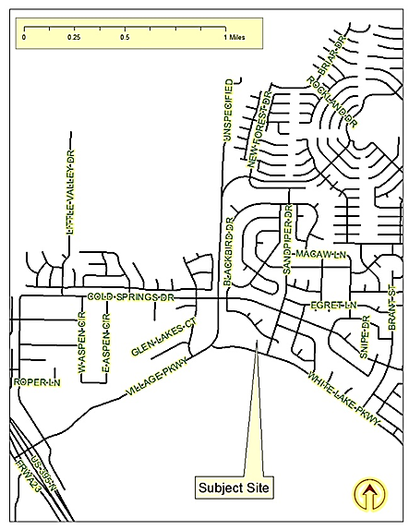
Location
3375 White Lake Parkway

Slide 3
Overview
Religious Assembly Use Type
8,400 square feet in size
North side of White Lake Parkway
Location and dimensions of the proposed building meet all Development Code requirements
Administrative Permit required

Slide 4
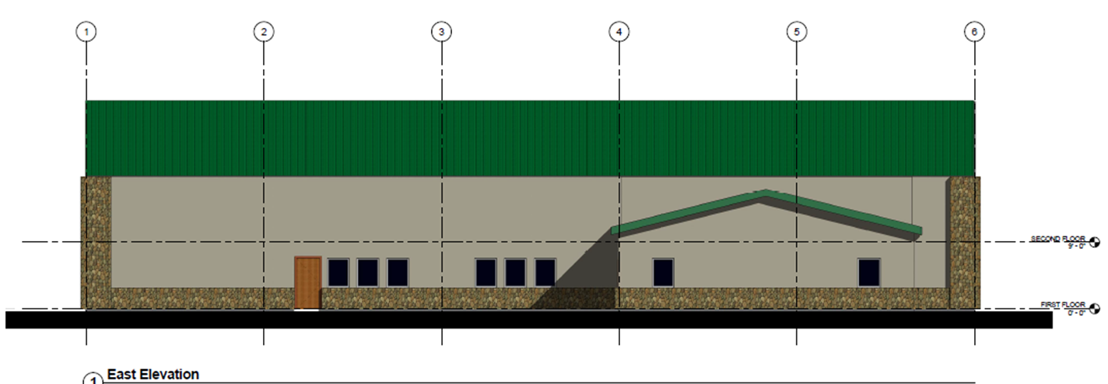
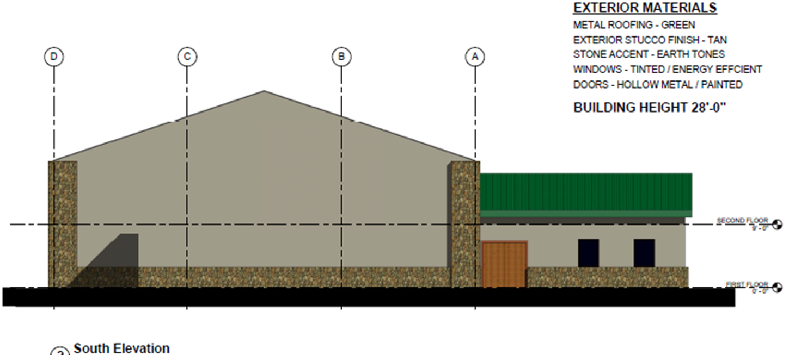
Building Elevations

Slide 5
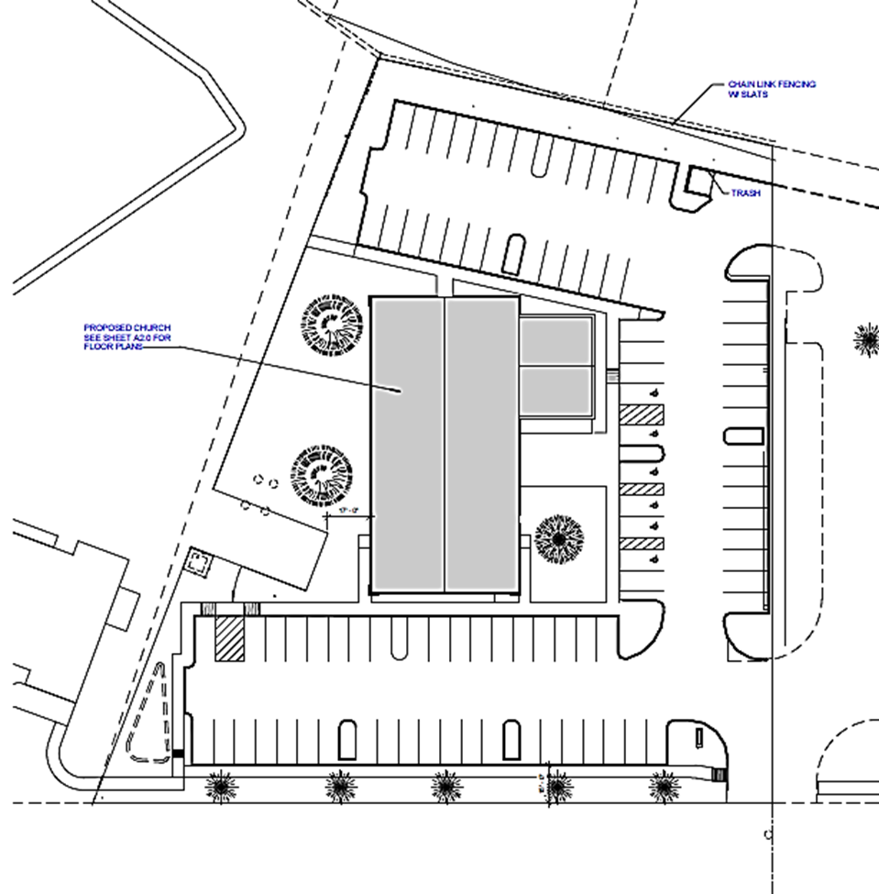
Site Plan

Slide 6
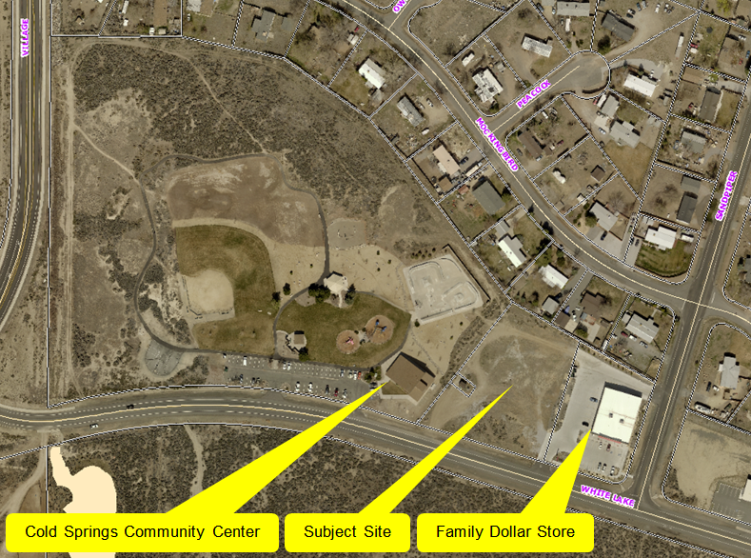
Overhead Photo

Slide 7
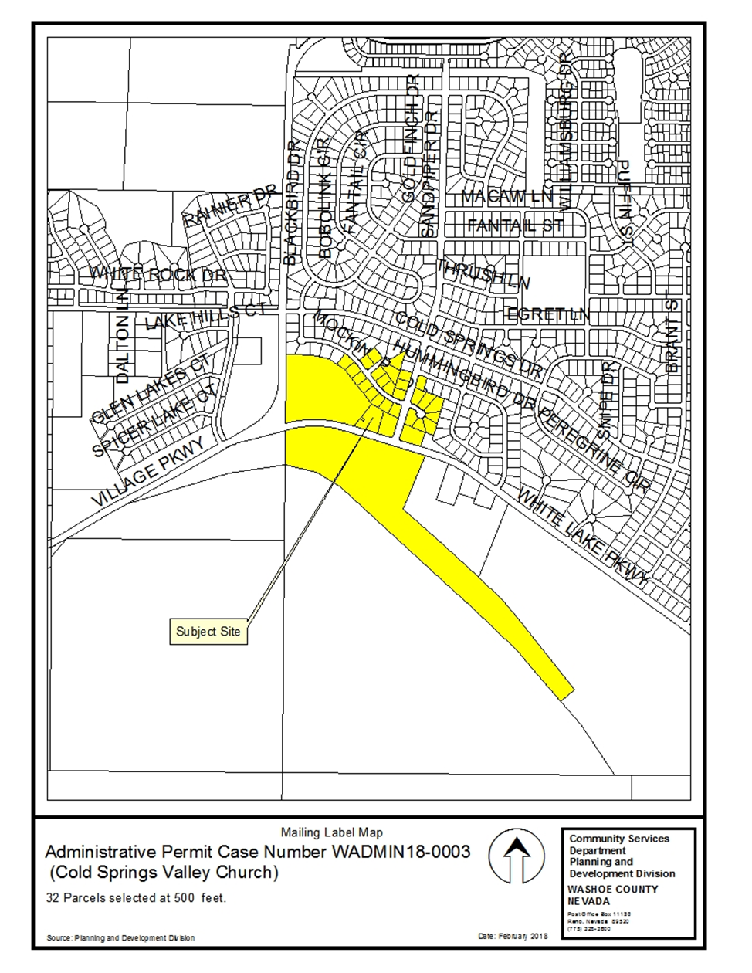
Public Notice and CAB
32 Parcels noticed at 500 foot radius
NVCAB on 3/12/2018 forwarded comments without recommendation:
Height
Location
Colors

Slide 8
Commenting Agencies
Washoe County Community Service
Planning and Building Division
Engineering and Capital Projects
Washoe County Health District

Slide 9
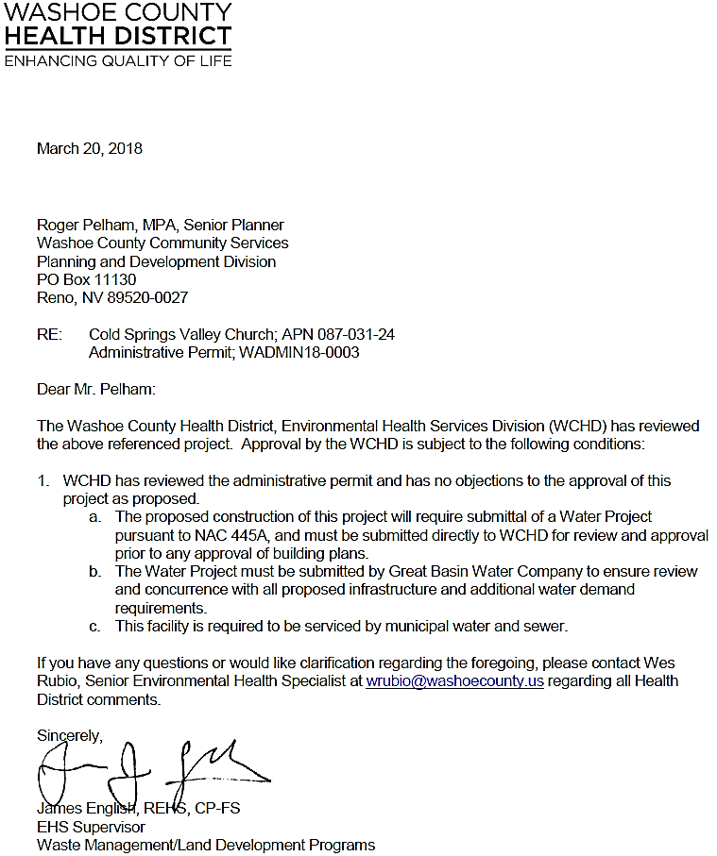

Slide 10
Health Conditions
The proposed construction of this project will require submittal of a Water Project pursuant to NAC 445A, and must be submitted directly to WCHD for review and approval prior to any approval of building plans.
The Water Project must be submitted by Great Basin Water Company to ensure review and concurrence with all proposed infrastructure and additional water demand requirements.
This facility is required to be serviced by municipal water and sewer.

Slide 11
Administrative Permit Findings
Findings and evaluation can be found on page 12 of the staff report.
Staff believes that all findings can be made and recommends approval with conditions, including the three additional conditions provided by the Health District.

Slide 12
Possible Motion
I move that, after giving reasoned consideration to the information contained in the staff report and information received during the public hearing, the Board of Adjustment approve Administrative Permit Case Number WADMIN18-0003 for Cold Springs Valley Church, with the conditions listed in the staff report and the three additional conditions provided by the Health District, having made all four findings in accordance with Washoe County Development Code Section 110.808.25.

